Slide 1
Inventory Management System: Related Works
By:
David Erickson
August Davis
Christian Hansen

Slide 2
Introduction
Goal of our project is Inventory Management
Service Major and Minor equipment around the University
Android, iOS, and Website

Slide 3
Google Vision
Software and API Developed by Google To Detect and Translate Visual Input Including:
Movement
Fecal Reignition
Barcodes
Notes:
We Need to scan barcodes in a non rescores intensive way
Google will Continue to Update This Product and Document it’s Changes

Slide 4
MySQL vs SQL Server vs SQLite
MySQL is a database software by Oracle. It has Visual studio integration and is cross platform. Has worse performance than SQL Server and SQLite.
SQL server is integrated into Visual Studio and Azure, making integration very easy. Can serve reports to mobile devices. This is also cross platform.
SQLite is designed to run without a centralized server. This limits size of the database to the size of the storage on the main device. It’s very fast when used on sites and apps with low traffic.
Notes:
MySQL is slower than the others, but is potentially faster than SQLite in larger databases or sites/apps with higher traffic.
SQL Server is our preferred option. Extremely easy to integrate, and I have experience in it. Reporting is important to give a visualization of the data to the user, and can be printed to give physical reports.
SQLite can become very slow as the database grows. Has features where changes can be made offline and then synced to the server when the connection is reestablished. It is not client server, it is embedded.
All of these are free to use so it comes down to what we feel is the best fit, which we decided is SQL Server. Its integration into Visual Studio is very important to us, and prior experience makes it a very easy choice.

Slide 5
Microsoft Azure
Provides cloud services to developers to build, deploy, and manage mobile applications.
Helps to transition between desktop systems and mobile systems.
Allows us to make updates even if connection to the database is lost, then upload the changes when a connection is established.
Pricing is based on consumption, the system is only used when needed.
Removes the need for IT support and administration.
Notes:
Heavily integrated into Visual Studio, so it would be very easy to use in our app.
This could be a good choice for us, but we already have servers on the UND campus, which may eliminate the need for this service.
A SQL database hosted through Azure costs $4.99 per month, which can be avoided by hosting it locally on campus, and we are getting in contact with someone to talk about hosting a server.

Slide 6
LINQ
Eases the transition from object oriented languages to relational queries.
Can write database queries, inserts, updates, and deletes in languages like C# instead of SQL.
Integrated into Visual Studio and SQL Server.
Allows us to utilize SQL Server’s security tools.
Notes:
This would let use a language like C# to write our database queries. Would make things very easy for us for database transactions
Again, integration is important, and would be very nice to use.

Slide 7
Microsoft Visual Studios
Offers
How it affects us
.NET
Azure
Xamarin
.NET provides Cross Platform
Azure allows secure remote connection to database
Xamarin offers more functions and can capture mobile functions.

Slide 8
The Family Educational Rights and Privacy Act (FERPA)
Establishes Student Information Handling Procedures
Sets Security Minimums on Student Information Storage
Sets Data Access Security Requirement Minimums
The final say on what’s kosher when it comes to student information
Notes:
The Application Will Be Handling Accounts Tied University Students and Staff
It Would Be Preferable To Piggyback Off the North Dakota University System (NDUS) Account System

Slide 9
SQL Security Pit Falls + SQL feature Documentation
The security pit falls articles highlights common points of security failure for SQL servers
SQL feature documentation allows us to build in countermeasures to the pit falls highlighted by the articles.
Building in countermeasures allows us to comply with FERPA
Notes:
The Applications Backend Will Be a SQL Server Bring
Knowing Possible Points Of Failure Allows For Countermeasures to be taken
Some Features Carry Security Requirements
Provides the tools to be used to:
Connect to the application
Close security holes
Connecting to the NDSU servers

Slide 10
University of North Dakota Identity Standards
Required guidelines
http://und.edu/identity/web-content-standards.cfm

Slide 11
Mobile User Experience Guidelines Article
Structured and chunked appropriately
Follow user interface guidelines
Use devices features
Test at multiple points
Collect data and user feedback
Develop security and privacy guidelines

Slide 12
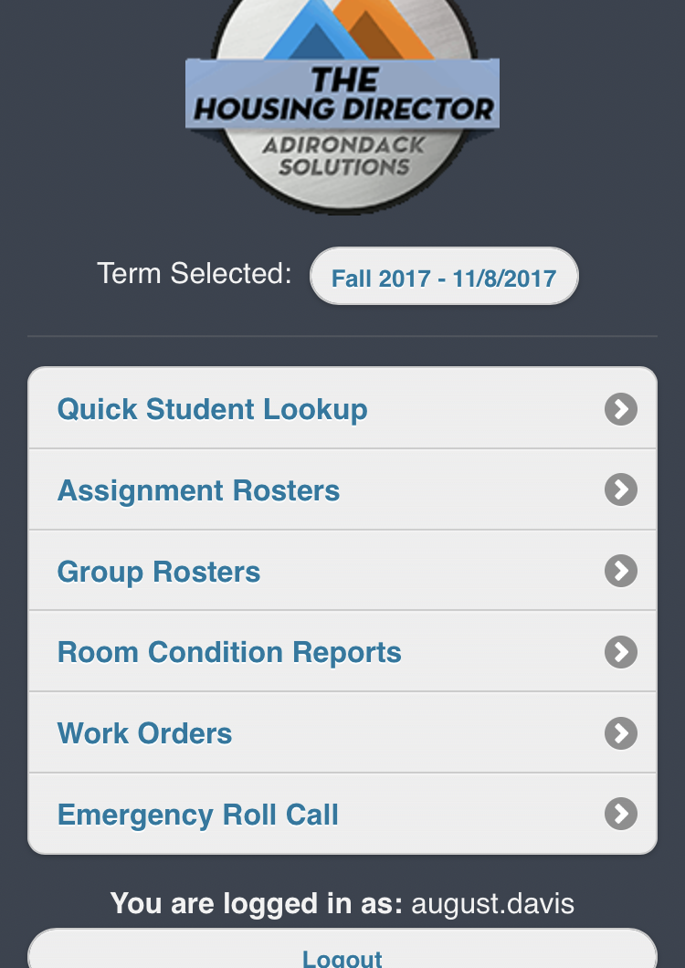
THD Mobile (Application)
Inventory Tracking App Used by Housing
A commercial Product Customized for the University
Notes:
User Quality of Life Failures
UI Design Form Vs. Function
Successes and Failures of Information Persistence Between Screens
Task Designed for Vs. Task Used for

Slide 13
Bibliography pt.1
[1] "Microsoft," [Online]. Available: https://www.visualstudio.com/vs/mobile-app-development/. [Accessed 25 10 2017].
[2] "Android Studio Features," [Online]. Available: https://developer.android.com/studio/features.html. [Accessed 25 10 2017].
[3] "Xamarin," [Online]. Available: https://www.xamarin.com/. [Accessed 25 10 2017].
[4] University of North Dakota, "Digital Content Standards," [Online]. Available: https://und.edu/identity/web-content-standards.cfm. [Accessed 25 10 2017].
[5] Digital Gov, "Mobile User Experience Guidelines and Recommendations," [Online]. Available: https://www.digitalgov.gov/resources/mobile-user-experience-guidelines-and-recommendations/. [Accessed 25 10 2017].
[6] "Microsoft Azure," [Online]. Available: https://azure.microsoft.com/en-us/services/app-service/mobile/ . [Accessed 25 10 2017].
[7] "SQL Server 2017," [Online]. Available: https://www.microsoft.com/en-us/sql-server/sql-server-2017. [Accessed 25 10 2017].
[8] "Oracle MySQL," [Online]. Available: https://www.mysql.com/why-mysql/windows/. [Accessed 25 10 2017].

Slide 14
Bibliography pt.2
[9] "Linq," [Online]. Available: https://msdn.microsoft.com/en-us/library/bb308959.aspx. [Accessed 25 10 2017].
[10] "SQLite," [Online]. Available: https://www.sqlite.org/. [Accessed 25 10 2017].
[11] "THD Mobile," [Online]. Available: https://prdhousing.ndus.edu/und_thd/mobile/index.cfm. [Accessed 25 10 2017].
[12] "Mobile Vision," [Online]. Available: https://developers.google.com/vision/android/barcodes-overview. [Accessed 25 10 2017].
[13] "Overview of SQL Server Security," Microsoft, 30 3 2017. [Online]. Available: https://docs.microsoft.com/en-us/dotnet/framework/data/adonet/sql/overview-of-sql-server-security. [Accessed 25 10 2017].
[14] "SQL Security Pit Falls," [Online]. Available: https://www.red-gate.com/simple-talk/sql/database-administration/how-to-get-sql-server-security-horribly-wrong/. [Accessed 25 10 2017].
[15] "FERPA," [Online]. Available: https://www2.ed.gov/policy/gen/guid/fpco/ferpa/index.html. [Accessed 25 10 2017].

